Slide 1
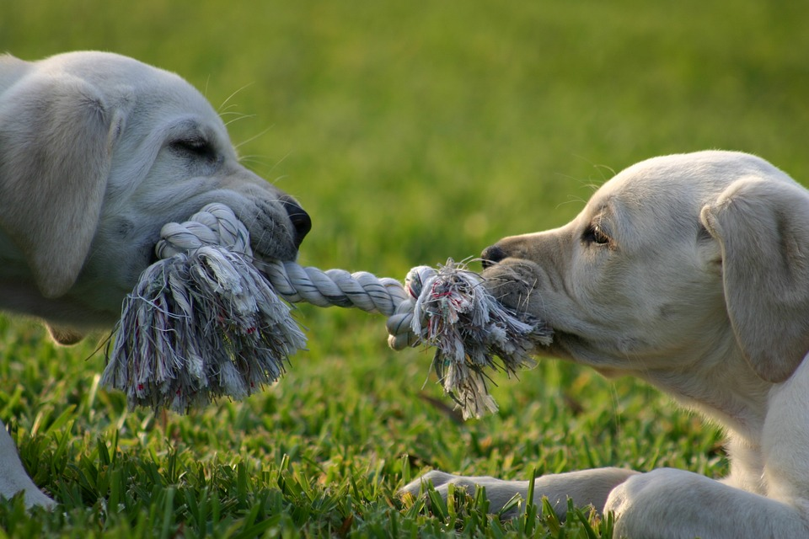
BALANCED AND UNBALANCED FORCES
We will compare balanced and unbalanced forces.
Notes:
Insert cover image and use transparency settings to fade image.

Slide 2
Do not delete this slide.
This slide is designed so that you can copy the prompt box you need and insert it into your slides.
This slide is hidden and will not be included when presenting your lesson.
TRACK WITH ME
VOCABULARY
1 -
HINT
Students, remember….
CHECK FOR UNDERSTANDING
READ WITH ME
TEACHER CUE
MAKE THE CONNECTION
Students, you already know….
EXTENSION
GESTURE WITH ME

Slide 3

Unjumble the words using the definition provided
OREFC a push, pull or twist
GINSPR ENLAACB tool used to measure force
TWNEON the unit force is measured in
YCEHMTRIS what we studied last term
ESTEHPOYSH prediction of what is going on
NTOEARIVBOS we make these with senses

Slide 4
Repeat the opposite word/phrase.
FORCE
A PUSH, PULL OR TWIST

Slide 5
Repeat the opposite word/phrase.
NEWTON (N)
UNIT OF MEASUREMENT FOR FORCE

Slide 6
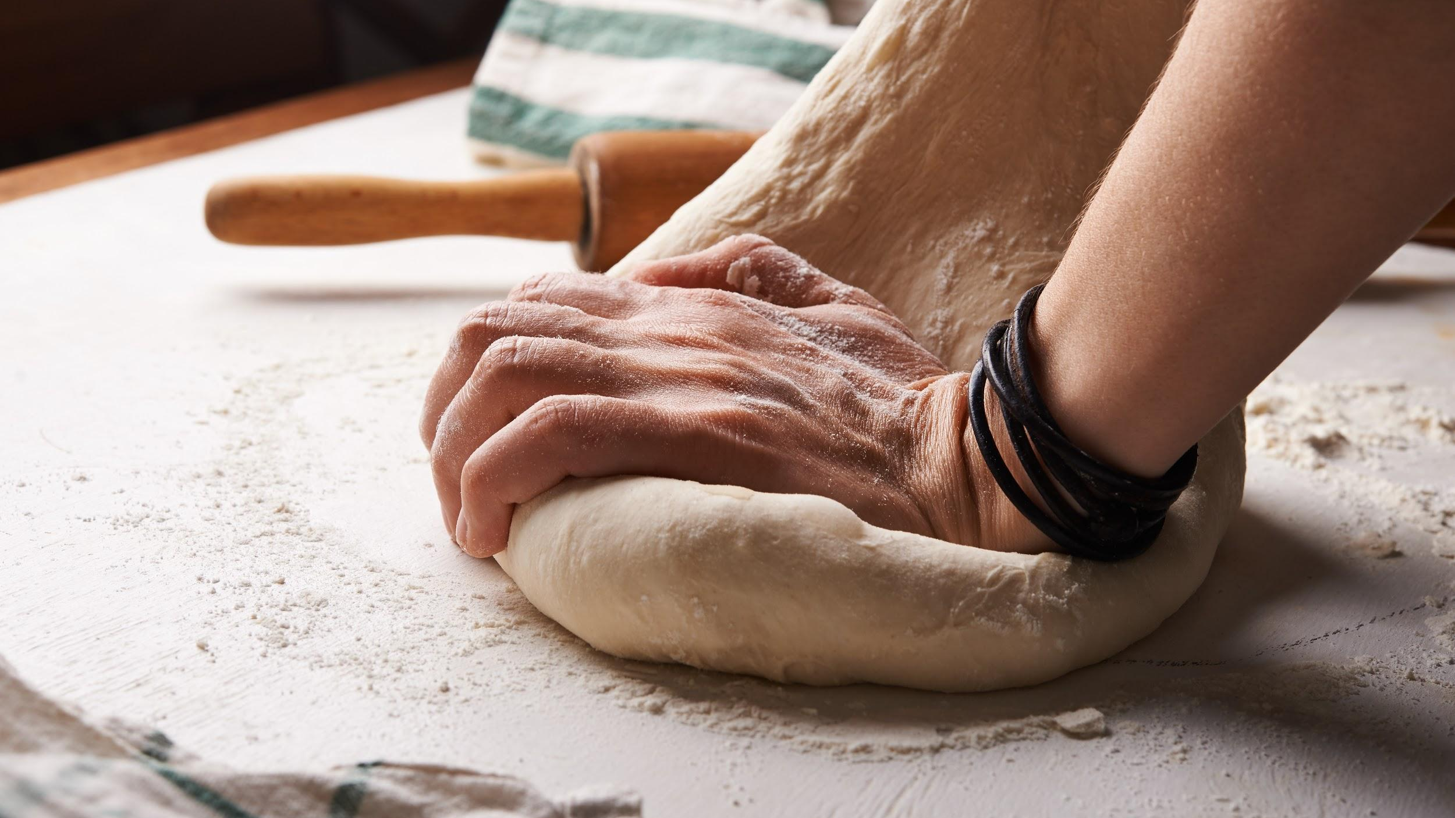
Is this a push, pull or twist?

Slide 7
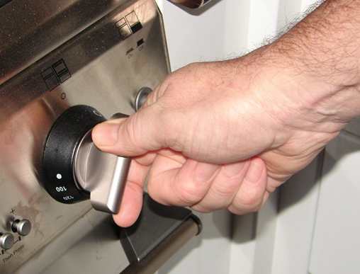
Is this a push, pull or twist?

Slide 8

Is this a push, pull or twist?

Slide 9
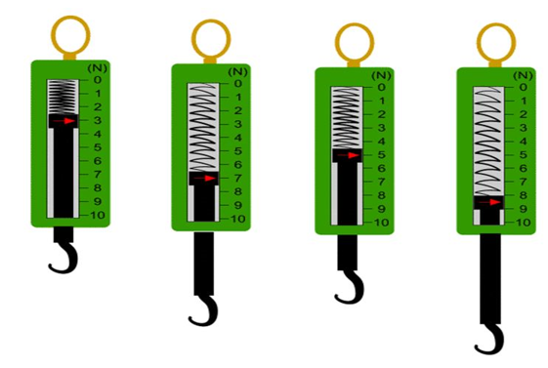
What measurement
does each of this spring balances read?

Slide 10
We will investigate forces
TRACK WITH ME
READ WITH ME
We will define balanced force.
We will define unbalanced force.
We will apply balanced and unbalanced forces to familiar examples.
We will explain the difference between balanced and unbalanced forces.
DECLARE THE OBJECTIVE
Read the learning objective to your partner.
Notes:
Learning Objectives contain concepts (nouns, big ideas), skills (verbs, measurable behaviours) and sometimes context (restricting or targeting conditions).
●Example: Students will be able to describe the concept of density and apply it to floating and sinking.
●
Success criteria are specific measurable outcomes that if met mean that the student has met the learning objective.
Examples:
•Students will be able to compare densities of substances using mass and volume.
•Students will be able to identify whether a solid or liquid will float or sink in a liquid based on their densities.

Slide 11
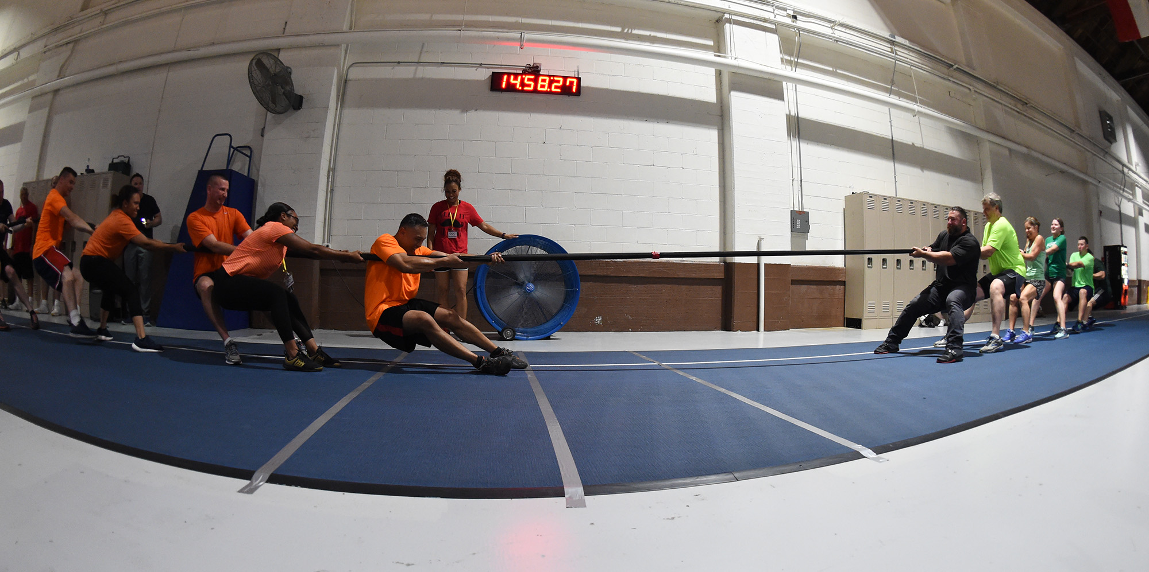
We will compare balanced and unbalanced forces.
Tug-of-war is involves forces of push and pull. Teams pull on the rope and remain standing because they push against the ground.
What do you think would happen if one team pulled harder than the other team (used more force)?
What do you think would happen if both teams pull the same amount (with the same amount of force)?
MAKE THE CONNECTION
Students, you already know a force is a push, pull or twist. We can measure force in newtons.

Slide 12
We will compare balanced and unbalanced forces.
CHECK FOR UNDERSTANDING
What do we call forces that are the same size? What happens in the picture below if there are balanced forces?
Forces₁ can be balanced or unbalanced.
So in the tug of war:
If one team uses more force, the forces are unbalanced forces₂. One force is larger than the other.
If both teams use the same amount of force, the forces are balanced forces₃. This means the forces are the same size or equal.
VOCABULARY
1 - a push, pull or twist. 2 - forces not equal in size. 3 - forces equal in size.

Slide 13
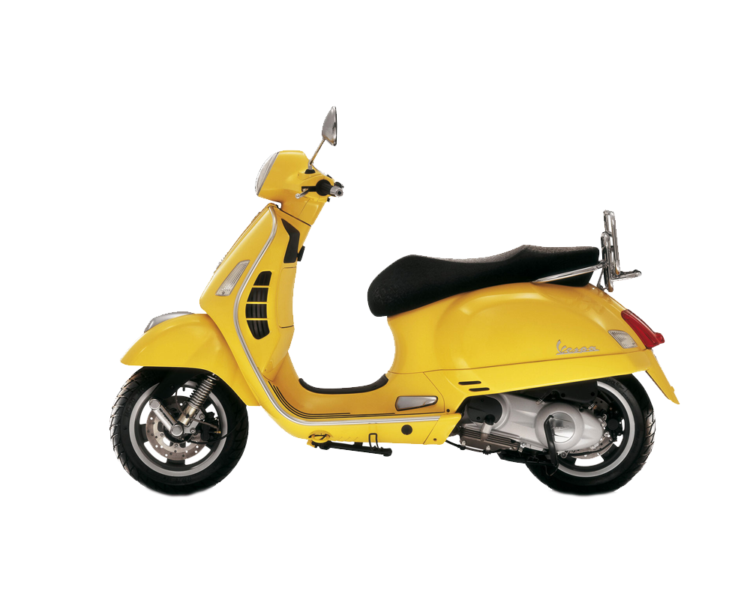
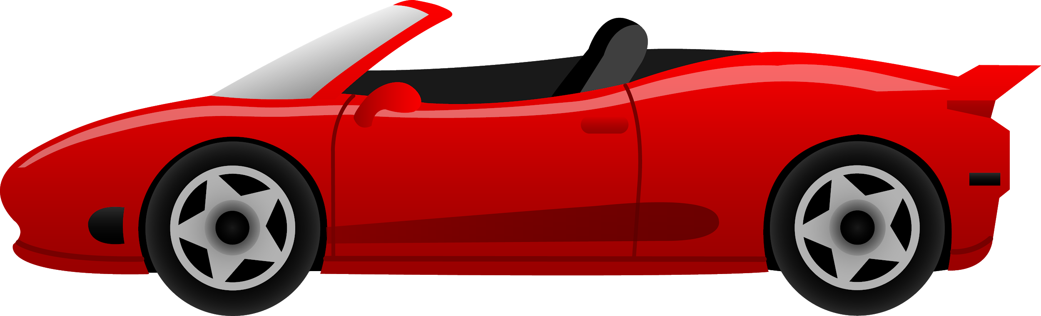
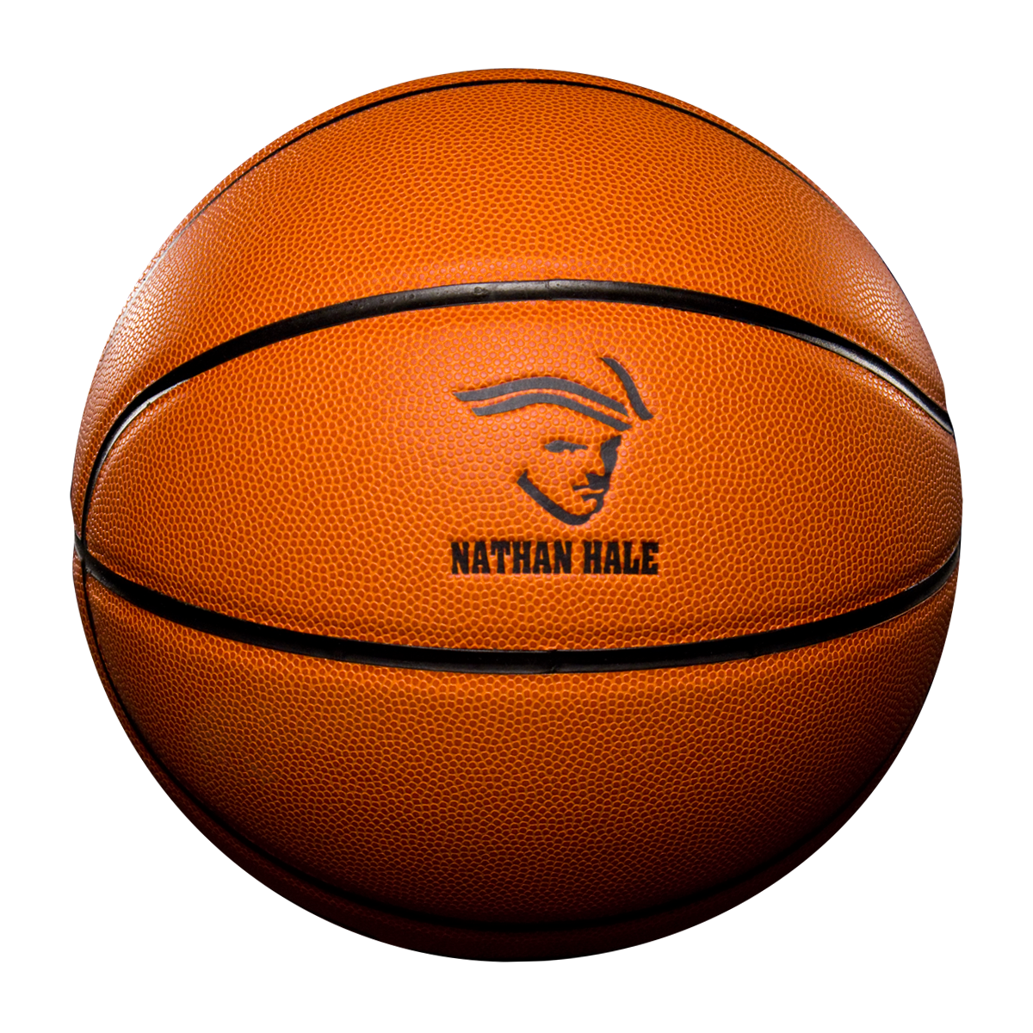
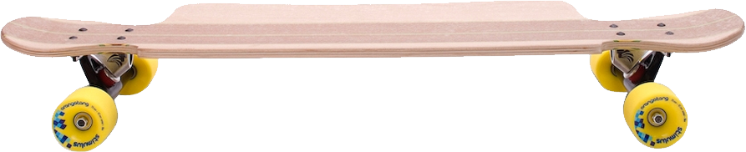
We will compare balanced and unbalanced forces.
CHECK FOR UNDERSTANDING
Would we use long or short arrows to show a strong force? How do we know the forces acting on the car are balanced?
Arrows can be used to show force acting on an object.
The direction of the arrow shows what way the force is acting. The longer the arrow, the greater the force.
Balanced forces are equal forces in opposite directions.
There is no movement. The object stays still.
Examples:
Non-Examples:

Slide 14
We will compare balanced and unbalanced forces.
CHECK FOR UNDERSTANDING
What happens to an object when there are unbalanced forces? Why aren’t the forces acting on the basketball unbalanced?
Unbalanced forces are unequal forces in opposite directions.
There is movement in the direction of the greater force.
Examples:
Non-Examples:

Slide 15
We will compare balanced and unbalanced forces.
Are the forces balanced or unbalanced?

Slide 16
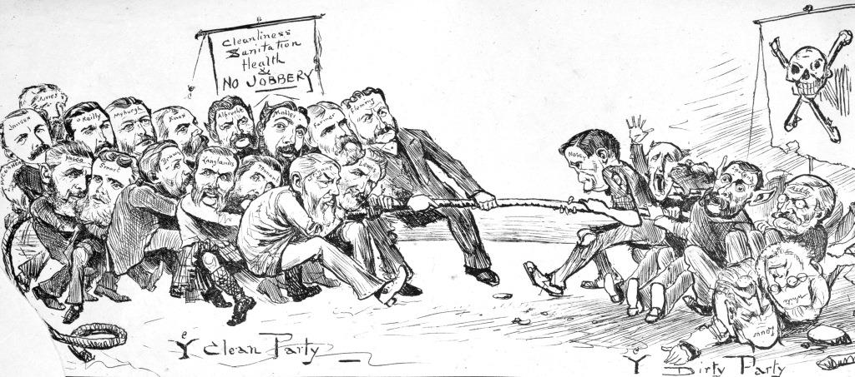
We will compare balanced and unbalanced forces.
Are the forces balanced or unbalanced?

Slide 17
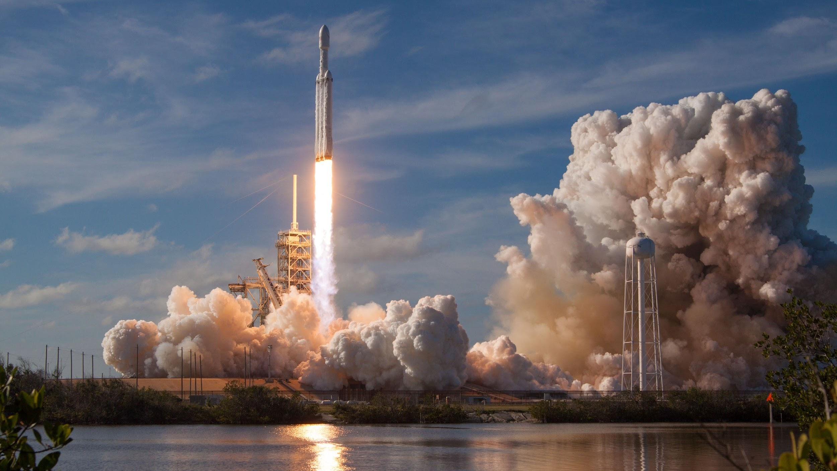
We will compare balanced and unbalanced forces.
Are the forces balanced or unbalanced?

Slide 18
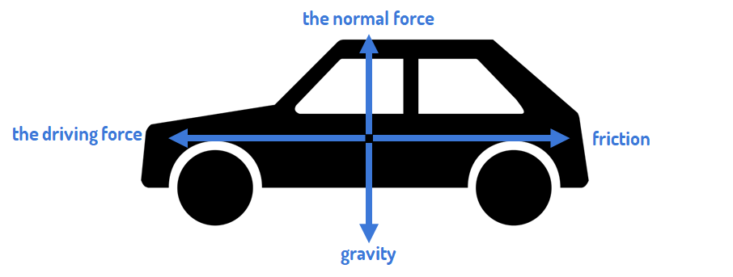
We will compare balanced and unbalanced forces.
Are the forces balanced or unbalanced?

Slide 19
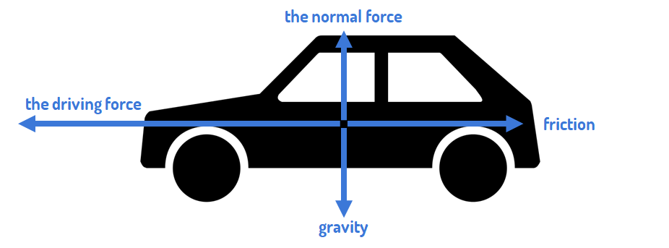
We will compare balanced and unbalanced forces.
Are the forces balanced or unbalanced?

Slide 20
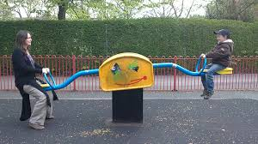
We will compare balanced and unbalanced forces.
Are the forces balanced or unbalanced?

Slide 21
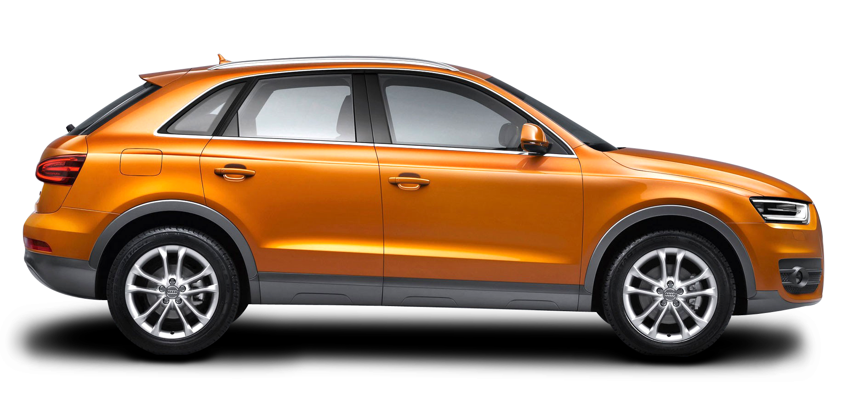
We will compare balanced and unbalanced forces.
Are the forces balanced or unbalanced?
Is the car moving or staying still?
HINT
Balanced forces are two forces equal in size acting on an object in opposite directions. Unbalanced forces are two forces not equal in size acting on an object. Forces can: Move something (acceleration) Stop something moving (deceleration) Change something’s direction Turn something Change something’s shape

Slide 22

We will compare balanced and unbalanced forces.
CHECK FOR UNDERSTANDING
True or False? An object will stay still until the forces are unbalanced. Forces are balanced for stationary₁ objects. Forces are balanced once an object becomes stationary₁ again.
If you want to move a stationary₁ object you need to create an unbalanced force₂.
If an object is stationary₁ it means that all forces are balanced.
To move the object, like with lifting weights, you need to push, pull or twist something, and unbalance the forces to make the object move.
VOCABULARY
1 - still or unmoving 2 - forces not equal in size.

Slide 23
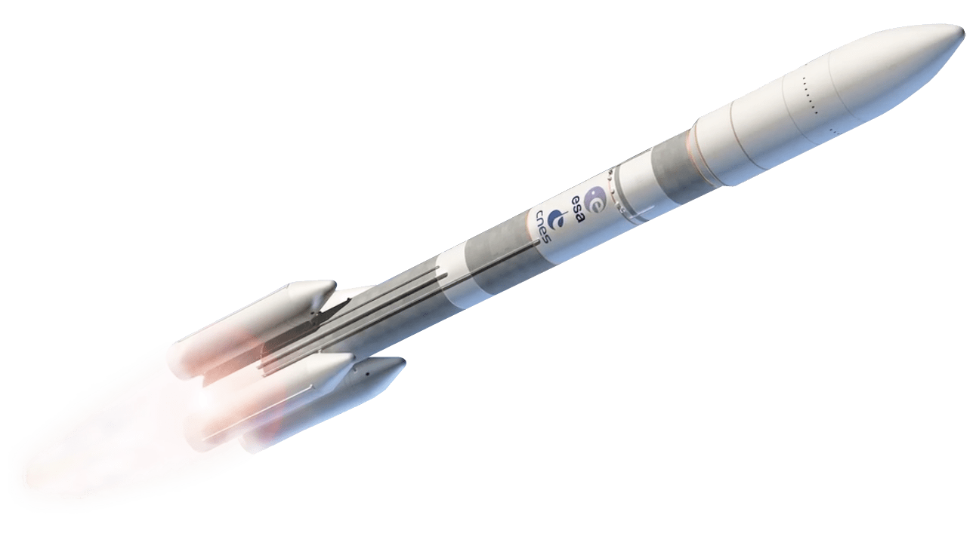
We will compare balanced and unbalanced forces.
CHECK FOR UNDERSTANDING
Are the forces acting on the rocket balanced or unbalanced? Explain your answer.
Arrows are used to show force acting on an object.
Balanced forces are equal forces in opposite directions.
There is no movement. The object stays still.
Unbalanced forces are unequal forces in opposite directions.
There is movement in the direction of the greater force.

Slide 24
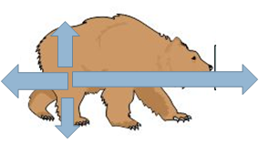

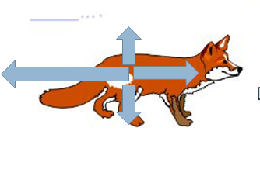
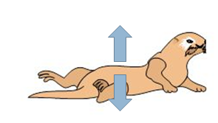
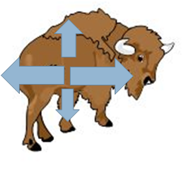
2 minutes
We will compare balanced and unbalanced forces.
Finish these sentences by filling in what the forces are causing to happen.
The yak is ______________.
The bear is _______________.
The otter is ____________.
The fox is ______________.
HINT
Students, remember…. Forces can: Move something (acceleration) Stop something moving (deceleration) Change something’s direction Turn something Change something’s shape

Slide 25
We will compare balanced and unbalanced forces.
Answer the questions below in your book.
What is a balanced force?
What is an unbalanced force?
What happens to the object when a balanced force becomes unbalanced?
Using arrows, draw an example of a balanced force.
Using arrows, draw an example of an unbalanced force.
5 minutes
Notes:
Please include tasks/questions here rather than just referring to a worksheet. This will save on photocopying and facilitate sharing with other schools.
Try and build tasks/questions which escalate through Bloom’s Taxonomy. This will help with differentiation.

Slide 26
We will compare balanced and unbalanced forces.
We will define balanced force.
We will define unbalanced force.
We will apply balanced and unbalanced forces to familiar examples.
We will explain the difference between balanced and unbalanced forces.
CHECK FOR UNDERSTANDING
Check Success Criteria.
Notes:
Learning Objectives contain concepts (nouns, big ideas), skills (verbs, measurable behaviours) and sometimes context (restricting or targeting conditions).
●Example: Students will be able to describe the concept of density and apply it to floating and sinking.
●
Success criteria are specific measurable outcomes that if met mean that the student has met the learning objective.
Examples:
•Students will be able to compare densities of substances using mass and volume.
•Students will be able to identify whether a solid or liquid will float or sink in a liquid based on their densities.

Slide 27
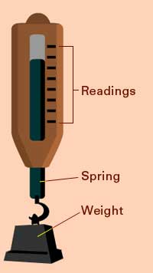
How many Newtons would these masses be?
Remember 1 kg = 10 Newtons
2 kg = _______ N
10 kg = ________ N
40 kg = ________ N
0.5 kg = ________ N
326 kg = ________ N

Slide 28
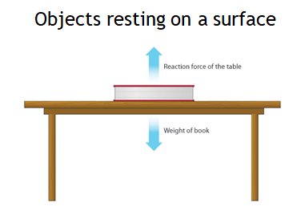
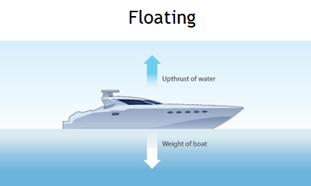
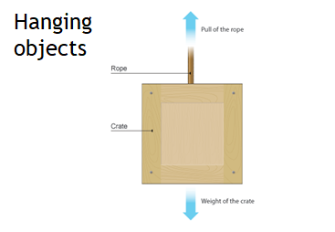
We will compare balanced and unbalanced forces.
When two forces acting on an object are equal in size but act in opposite directions, we say that they are balanced forces₁.
If the forces on an object are balanced this is what happens:
an object that is not moving stays still
an object that is moving continues to move at the same speed and in the same direction
CHECK FOR UNDERSTANDING
What are balanced forces? What happens when a force is balanced? What is an example of a balanced force?
VOCABULARY
1 - forces equal in size.

Slide 29

We will compare balanced and unbalanced forces.
When two forces acting on an object are not equal in size, we say that they are unbalanced forces₁.
If the forces on an object are unbalanced this is what happens:
an object that is not moving starts to move
an object that is moving changes speed or direction
CHECK FOR UNDERSTANDING
What is an unbalanced force? What happens when forces are unbalanced?
Car speeding up
5 N
15 N
VOCABULARY
1- forces not equal in size.

Slide 30
CHECK FOR UNDERSTANDING
What two things does a force arrow show? In the picture below, which arrow is the longest? What direction is it acting in? What is it called? What is its size in newtons?
We will compare balanced and unbalanced forces.
We can show the forces acting on an object using a force diagram₁. In a force diagram, each force is shown as a force arrow.
An arrow shows:
the size of the force (the longer the arrow, the bigger the force)
the direction in which the force acts.
The arrow is usually labelled with:
the name of the force and
its size in newtons.
VOCABULARY
1 - diagram showing all the forces acting on an object
5N
15N
25N
5N

Slide 31
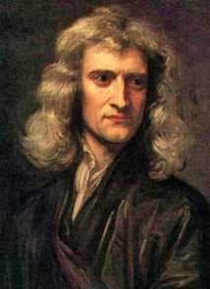
We will compare balanced and unbalanced forces.
CHECK FOR UNDERSTANDING
True or False? Only one force acts on an object.
Almost all objects have more than one force that acts on them.
Sir Isaac Newton was a 17th Century English scientist who was interested in a lot of different areas of science, but particularly Physics₁.
Newton came up with three laws of motion that tell us the rules of how objects move, and how forces are acting on them.
VOCABULARY
1 - area of science concerned with the nature and properties of matter and energy

Slide 32
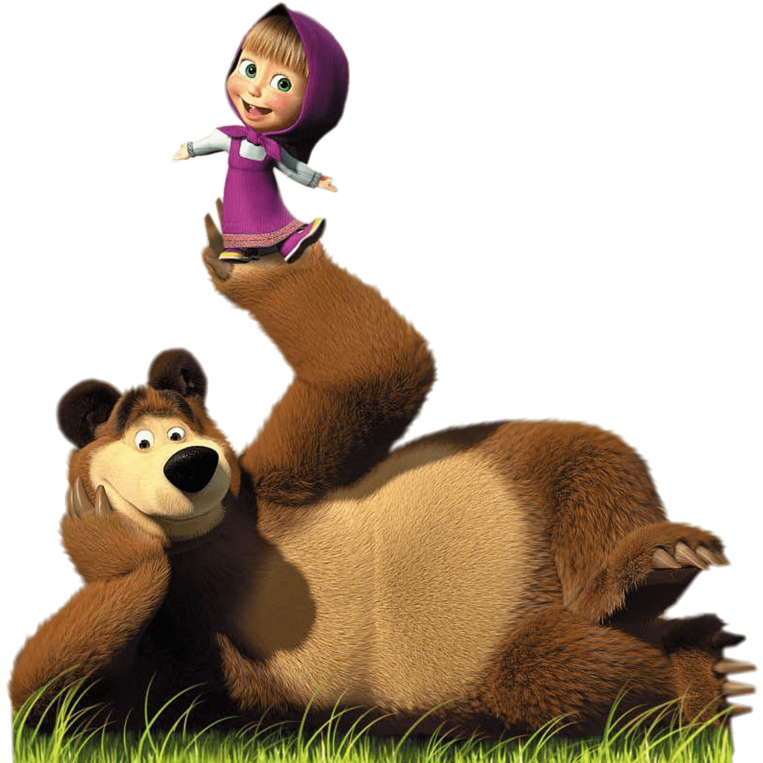
We will compare balanced and unbalanced forces.
Newton’s 1st Law of Motion:
An object either remains at rest or continues to move at a constant speed, unless acted upon by a force.
This means if an object is not moving, it will not start moving by itself. If an object is moving, it will not stop or change direction unless something pushes it.
Newton’s 1st Law is really talking about balanced forces₁ and unbalanced forces₂.
If all forces₃ on an object are balanced then nothing changes. If a force₃ on an object is unbalanced then the object will speed up, slow down, or change direction or shape.
CHECK FOR UNDERSTANDING
What happens if… All forces are balanced? A force on an object is unbalanced?
VOCABULARY
1 - forces equal in size. 2 - forces not equal in size. 3 - a push, pull or twist.

Slide 33

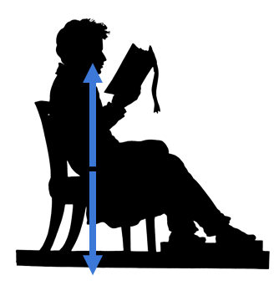
We will compare balanced and unbalanced forces.
The man on the chair isn’t moving, so the forces must be balanced.
CHECK FOR UNDERSTANDING
How do we know the forces are balanced?
What force is acting in the opposite direction to gravity?
The chair is supporting the man, pushing up against him. We call this force that comes from the ground (or, something on the ground in this case) the normal force.

Slide 34
We will compare balanced and unbalanced forces.
The car has four forces that are acting on it.
These forces are balanced, so this means the car is travelling at a constant₁ speed (not speeding up or slowing down).
CHECK FOR UNDERSTANDING
How many forces are acting on the car? What does constant speed mean?
VOCABULARY
1 - does not change.

Slide 35
We will compare balanced and unbalanced forces.
If the driving force is bigger/stronger than the force of friction, then the forces are unbalanced and the car will increase speed.
That is, it will speed up in the direction of the larger force.
CHECK FOR UNDERSTANDING
Which direction will the car speed up in?

Slide 36
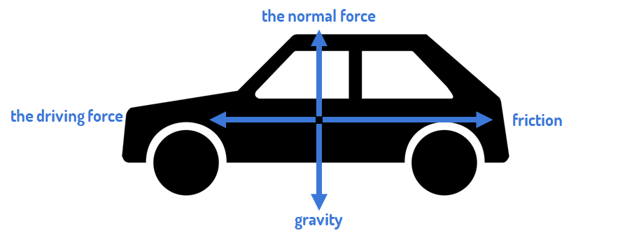
We will compare balanced and unbalanced forces.
If the driving force is smaller/weaker than the force of friction, then the forces are unbalanced and the car will slow down.
CHECK FOR UNDERSTANDING
True or False? This car will speed up.

Slide 37
We will compare balanced and unbalanced forces.
Are the forces balanced or unbalanced?

Slide 38
We will compare balanced and unbalanced forces.
Are the forces balanced or unbalanced?

Slide 39
We will compare balanced and unbalanced forces.
Are the forces balanced or unbalanced?

Slide 40
We will compare balanced and unbalanced forces.
Finish these sentences by filling in what the forces are causing to happen.
The yak is ______________.
The bear is _______________.
The otter is ____________.
The fox is ______________.
HINT
Students, remember…. Forces can: Move something (acceleration) Stop something moving (deceleration) Change something’s direction Turn something Change something’s shape

